Slide 1
Tourism Website
Under the Guidance of
Mr. Phaniraj B N
Project Members
Aishwarya Chimmalagi
Kushal Minachi
Shashank Shekhar PandeY
Vatsala Tamrakar

Slide 2
Contents
Introduction.
Problem Statement.
Motivation.
System Design.
Use Case Diagrams.
Snapshots.
Software Used.

Slide 3
INTRODUCTION
The proposed system is a web based application and maintains a centralized repository of all travel related information.
The system allows one to easily access the relevant information and make necessary travel arrangements.
Users can decide about places they want to visit for travel and accommodation.

Slide 4
Problem Statement
To develop a system that simplifies the processes and activities of a travel and tourism agency.

Slide 5
Motivation
To streamline the process of acquiring the desired information of your favorite travel destination like transportation details, nearby hotels, and more.
Easily make the necessary travel and accommodation arrangements.

Slide 6
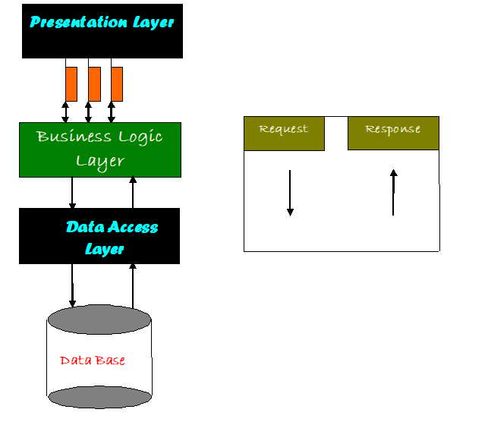
System Design

Slide 7
Presentation Layer:
Also called as client layer, comprises of components that are dedicated to presenting the data to the user. For example: Windows/Web Forms and buttons, edit boxes, Text boxes, labels, grids, etc.
Business Logic Layer:
This layer encapsulates the Business rules or the business logic of the encapsulations. To have a separate layer for business logic is of a great advantage. This is because any changes in Business Rules can be easily handled in this layer. As long as the interface between the layers remains the same, any changes to the functionality/processing logic in this layer can be made without impacting the others. A lot of client-server apps failed to implement successfully as changing the business logic was a painful process.
Data Access Layer:
This layer comprises of components that help in accessing the Database. If used in the right way, this layer provides a level of abstraction for the database structures. Simply put changes made to the database, tables etc. do not affect the rest of the application because of the Data Access layer. The different application layers send the data requests to this layer and receive the response from this layer.
Database Layer:
This layer comprises of the Database Components such as DB Files, Tables, Views, etc. The Actual database could be created using SQL Server, Flat files, etc. In an n-tier application, the entire application can be implemented in such a way that it is independent of the actual Database. For instance, you could change the Database Location with minimal changes to Data Access Layer. The rest of the Application should remain unaffected

Slide 8
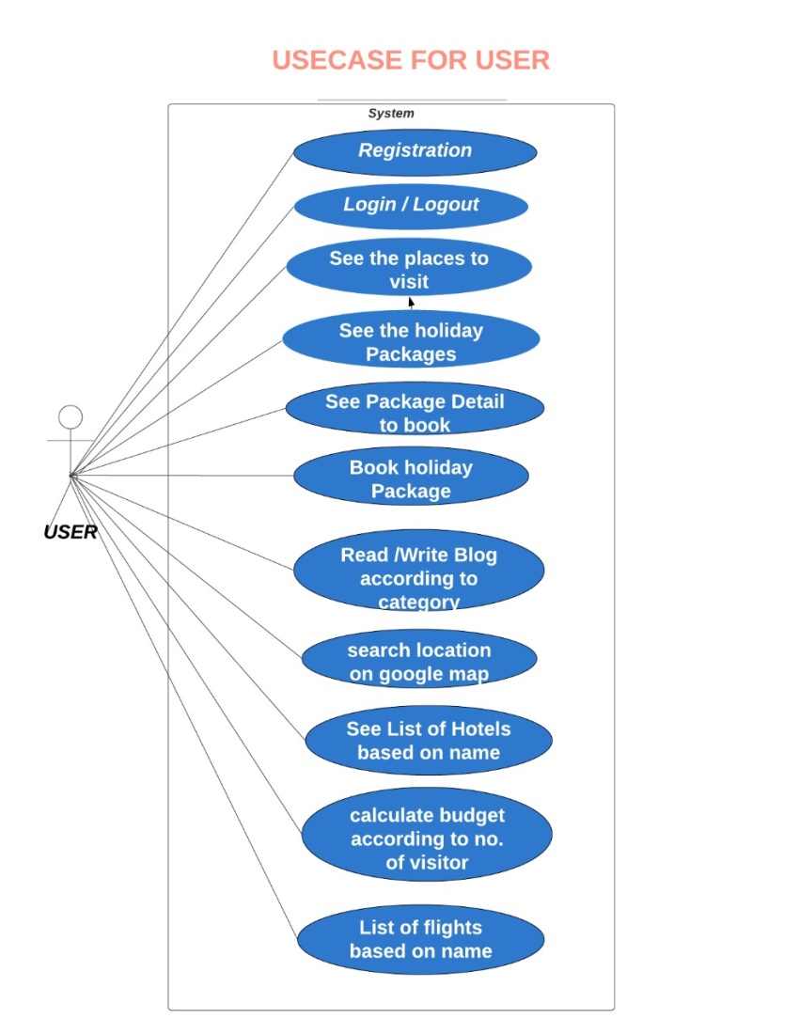
USE CASE DIAGRAMS

Slide 9
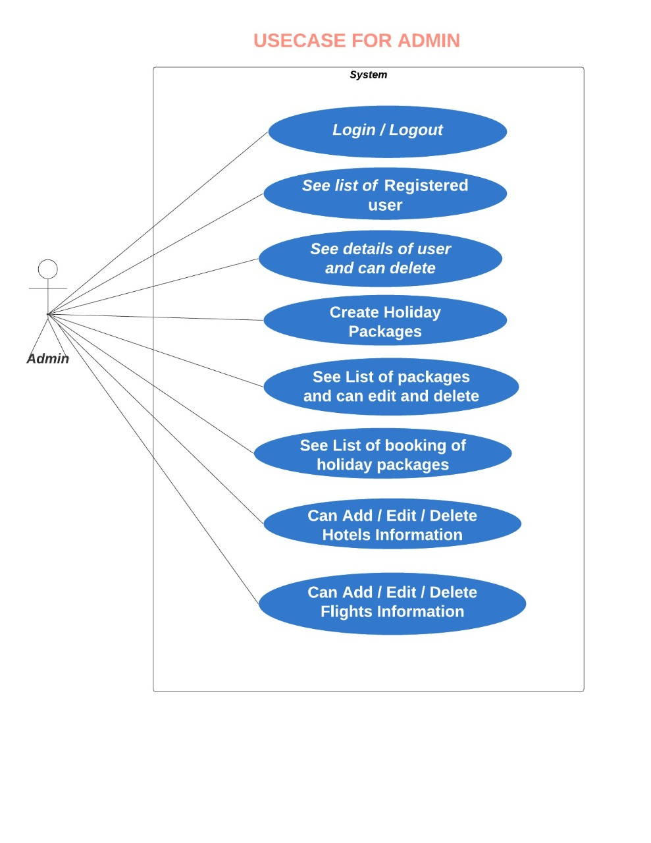

Slide 10
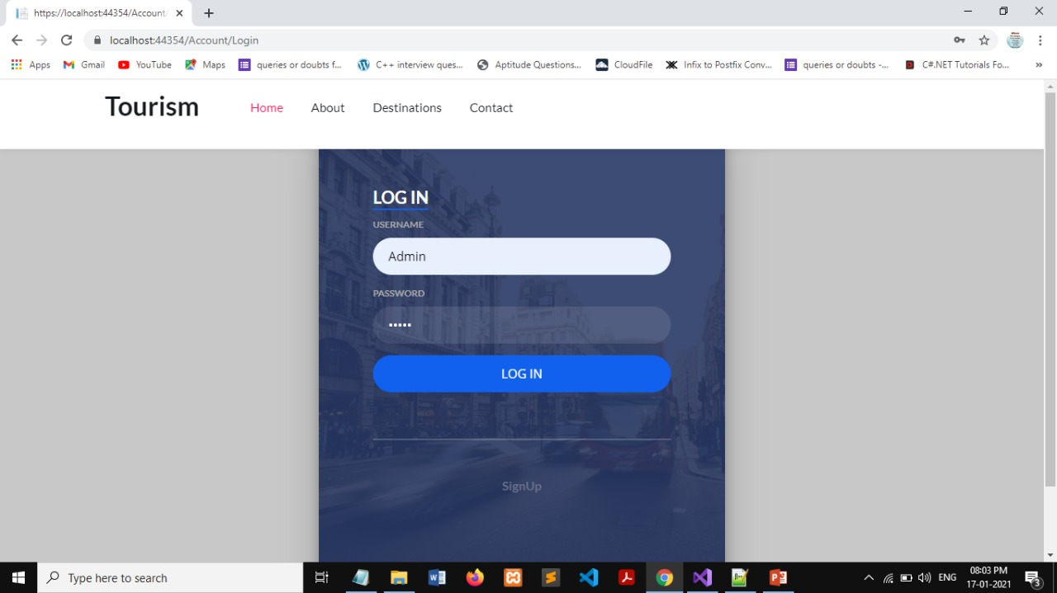
Screenshots

Slide 11
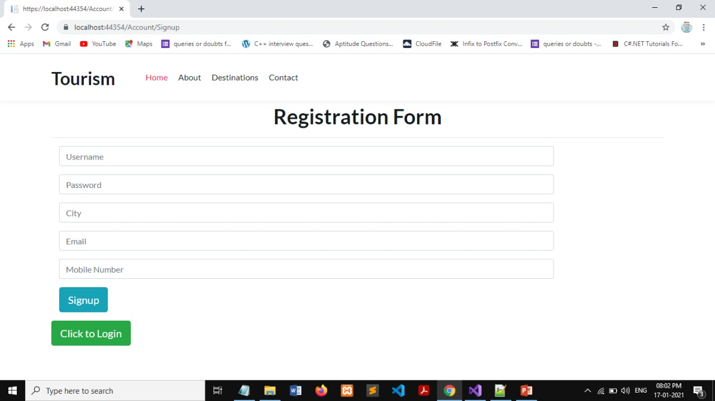

Slide 12
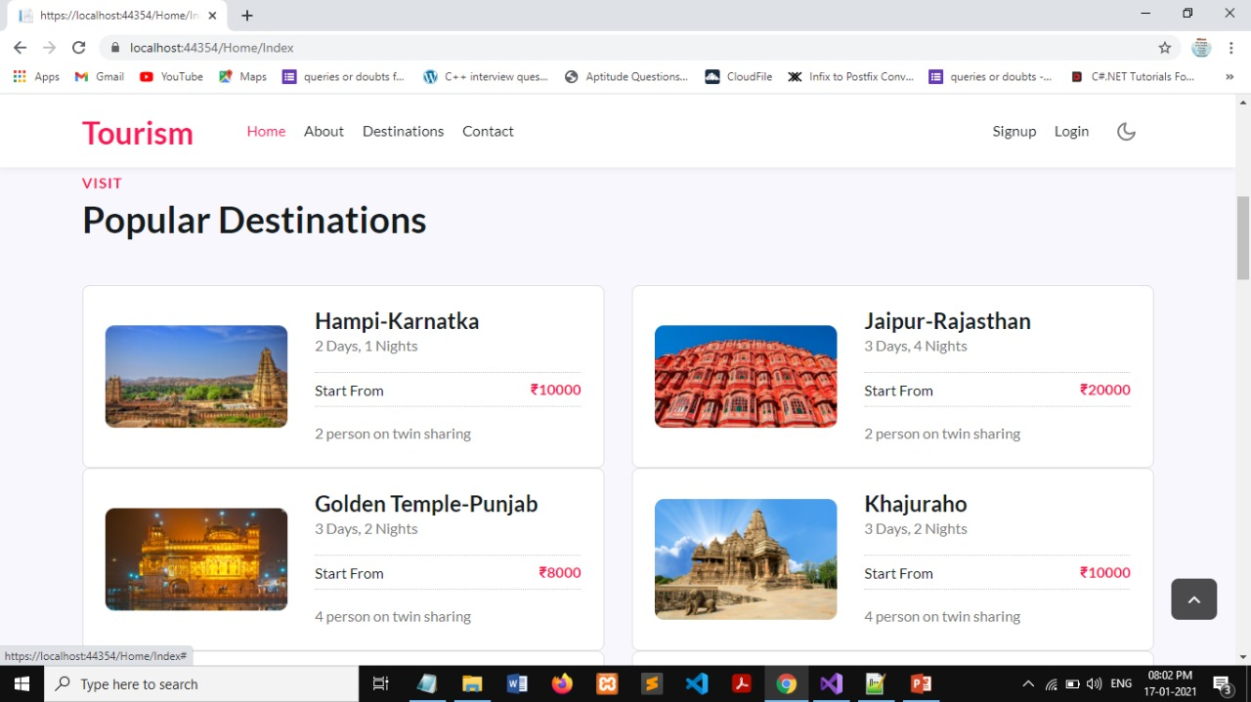

Slide 13
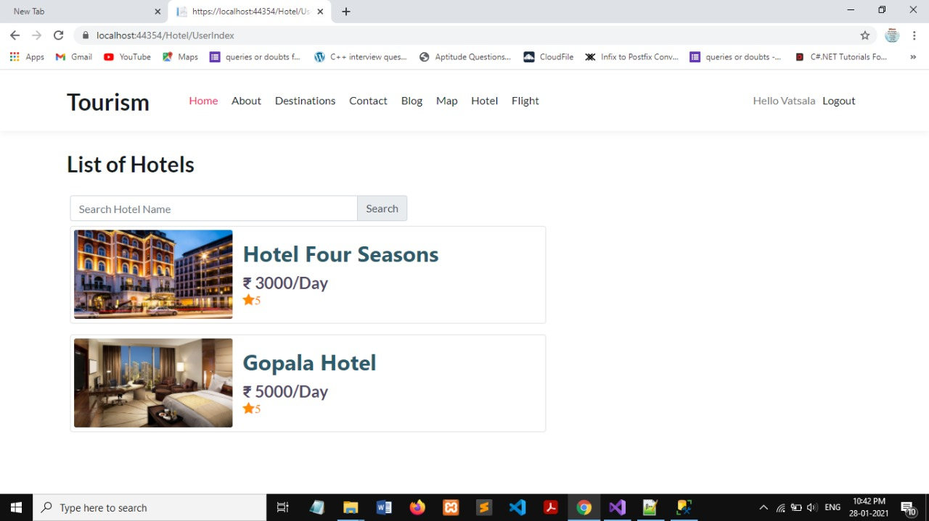

Slide 14
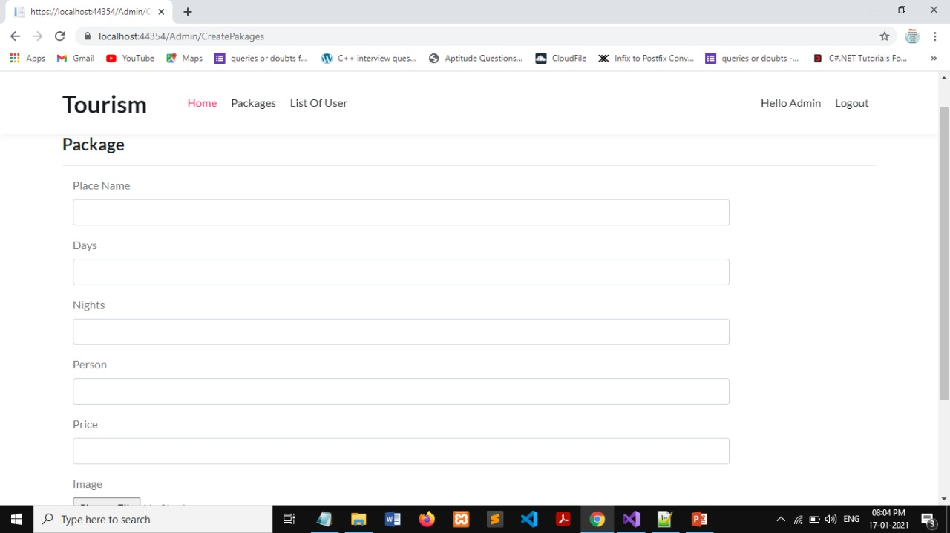

Slide 15
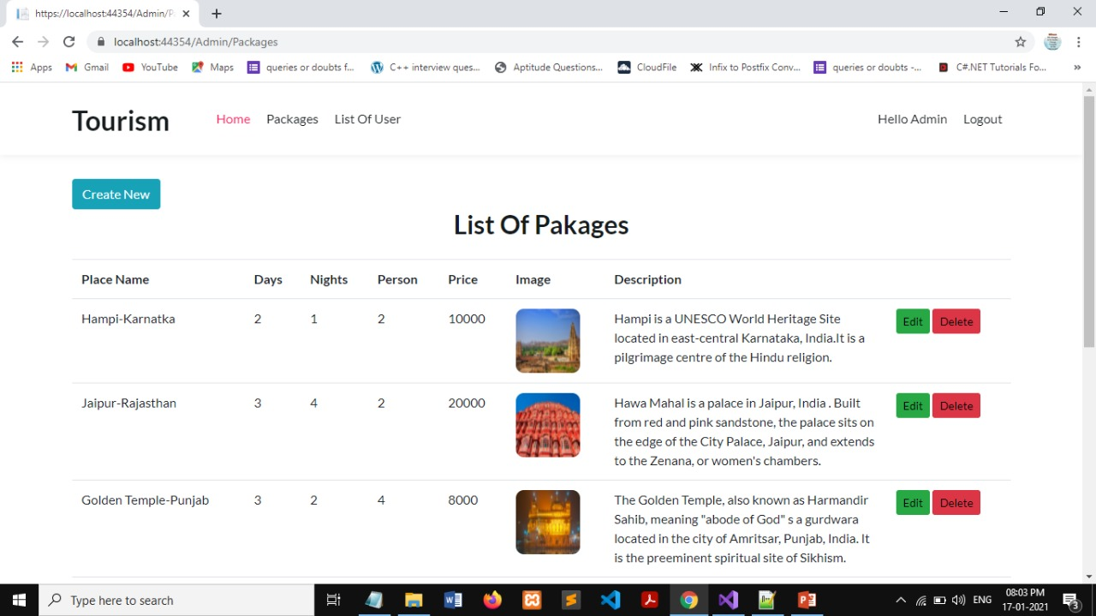

Slide 16
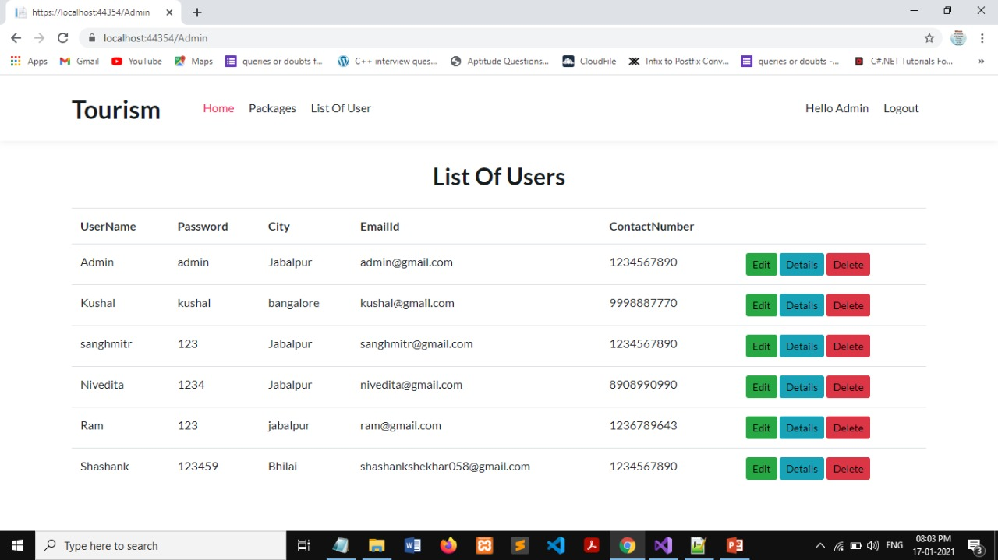

Slide 17
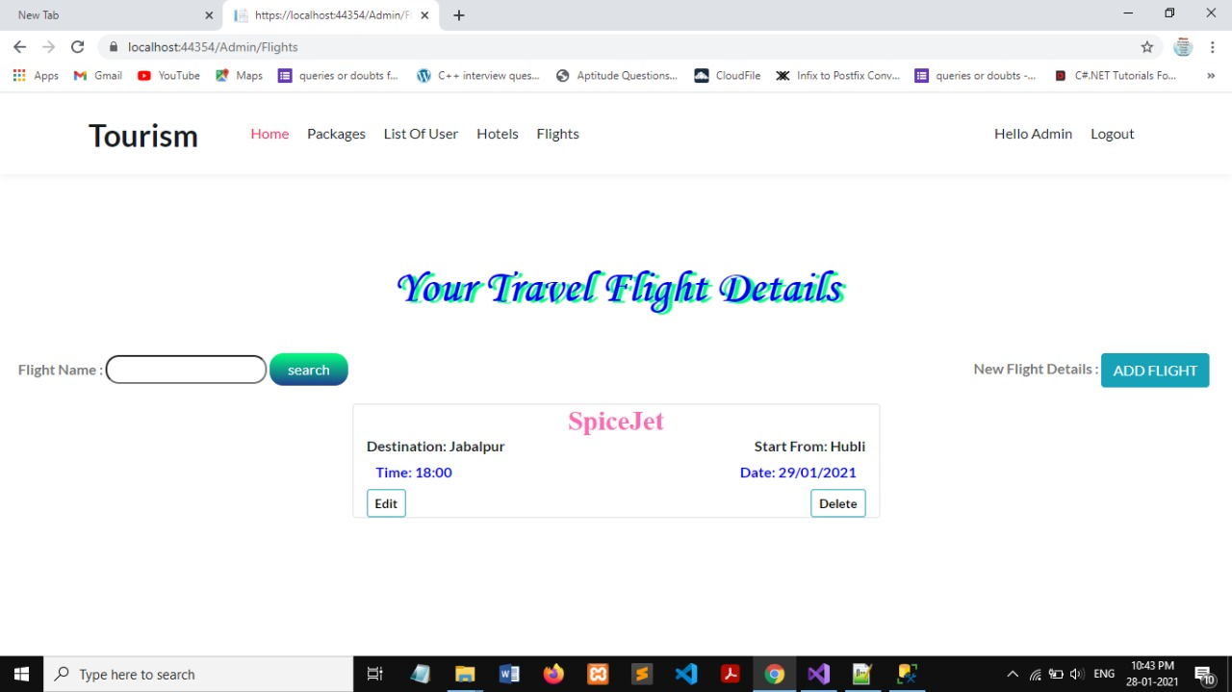

Slide 18
Software & Hardware Requirements
SOFTWARE REQUIREMENTS:
Operating System : Windows.
Technology : C#, .NET, MVC.
Web Technologies : Html, JavaScript, CSS, Bootstrap.
IDE : Visual Studio 2019.
Web Server : IIS/Express.
Database : SQL Server.
HARDWARE REQUIREMENTS:
Hardware : processor Intel i3 or higher, 2 Ghz or higher.
RAM : 1 GB or higher.

Slide 19
THANK
YOU

